Slide 1
Project Management

Slide 2
What is Project Management?
method for organizing tasks
structured framework to help a group work productively
tools to aid in task sequencing, dependency analysis, resource allocation, scheduling, etc.
tools to track progress relative to plan
Notes:
Project management has developed over the years, and involves various activities before a project is completed. Objectives should be specific so they are measurable, and although there may be one major project objective, there may be minor objectives throughout the project.

Slide 3
Why Project Management?
Projects need coordination of:
  Multiple people
  Multiple resources (labs, equipment, etc.)
  Multiple tasks – some must precede others
  Multiple decision points – approvals
  Phased expenditure of funds
  Matching of people/resources to tasks

Slide 4
Reasons Projects Fail
Poor project and program management discipline
Lack of executive-level support
No linkage to the business strategy
Wrong team members
No measures for evaluating the success of the project
No risk management
Inability to manage change

Slide 5
Project Success Criteria
On time
On budget
Meeting the goals that have been agreed upon

Slide 6
What is a Project?
Temporary with specific start and end dates
Unique
Progress elaboration
a large or major undertaking, especially one involving considerable money, personnel, and equipment
Planned set of interrelated tasks to be executed over a fixed period and within certain cost and other limitations

Slide 7
Task Dependencies & Critical Path
Sometimes task B cannot be started before task A is completed
Other types of constraints – calendar, lags, etc.
Critical path – any slippage slips whole project
Helpful to know what tasks are on the critical path
Useful to try to shorten the critical path

Slide 8
Project Manager
Ultimately responsible for the Project’s Succes
Plan and Act
Focus on the project’s end
Be a manager and a leader

Slide 9
Traits of Good Project Managers
Enthusiasm for the project
Ability to manage change effectively
A tolerant attitude toward ambiguity
Team building and negotiating skills
A customer-first orientation
Adherence to the priorities of business
Knowledge of the industry or technology

Slide 10
Rules for Success
Gain consensus on project outcome
Build the best team possible
Develop a comprehensive viable plan and keep it up to date
Determine what is needed to really get things done
Realistic schedule
Don’t do more than can be done
Remember people count
Notes:
Rule for success as a project manager

Slide 11
Rules Cont’d
Gain the formal and ongoing support of management and stakeholders
Be willing to change
Keep everyone informed
Try new things
Be a leader

Slide 12
Project Management
Application of knowledge, skills, tools and techniques to project activities to meet project requirements
9 knowledge areas:

Slide 13
Integration Management
Fitting everything together
Planning
Project Changes

Slide 14
Project Scope Management
Clear scope statement
Prevent scope creep

Slide 15
Project Time Management
Time and Schedule
  Planning
  Managing

Slide 16
Project Cost Management
Manage costs
  Out of your control
  Competing projects

Slide 17
Project Quality Management
Planning quality
Enforcing quality
Checking quality control

Slide 18
Project Human Resource Management
Organizational planning
Staff acquisition
Making a team

Slide 19
Project Communications Management
Communication plan

Slide 20
Project Risk Management
Risk management plan

Slide 21
Project Procurement Management
Acquisition and contract management

Slide 22
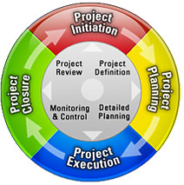
Project Life Cycle
Chapter 5

Slide 23
Project Definition Phase
Initiate the project
Identify the Project Manager
Develop the Project Charter
Conduct a Feasibility Study
Define Planning Phase
Sign off on the Project Charter

Slide 24
Project Planning Phase
Organize and staff the project
Develop a Project Plan
Sign off on the Project Plan

Slide 25
Project Execution Phase
Execute the Project Plan
Manage the Project Plan
Implement the project’s results
Sign off on project’s completion

Slide 26
Project Close-out Phase
Document the lessons learned during the project
After-implementation review
Provide performance feedback
Close-out contracts
Complete administrative close-out
Deliver project completion report

Slide 27
Project Life Cycle Flow
Partial Answer
Execution
Solution Space
Know
HOW
Project Planning
Problem Space
Don’t Know
Partial Answer
Project Definition
Know
Don’t Know
WHAT

Slide 28
Suggested Steps in
Project Management
Generate a formal definition of the project, with goals, constraints, assumptions
Identify project start/end dates, any mandatory milestones, including reports, signoffs, deliverables, etc.
List constraints – money, equipment availability, holidays, etc.
Identify tasks to be accomplished – high level (i.e., by categories), then details within each, using brainstorming method – green light

Slide 29
Suggested Steps, cont.
Refine detailed task list, dropping/ combining, adding things omitted
Then, for each task in list:
Estimate time (person hours, calendar period)
Identify dependencies among tasks
Identify resources (people, money, parts, etc.)

Slide 30
Suggested Steps, cont.
Organize task groups roughly by starting date
List dependencies that should or MUST hold
Use MS Project to make a GANTT chart
First capture tasks and task groups, milestones
Identify critical path, see if it can be shortened (get more “slack”)
Assign person-hours and specific team member(s) to each task – identify “task leads”

Slide 31
Suggested Steps, cont.
As project progresses:
Monitor, record progress on all tasks, at least weekly – use “Tracking Gantt Chart”
Pay particular attention to those on critical path
Revise plan as needed to take into account changes, adapt to meet milestones

Slide 32
Project Management Using software
Allows many different ways of entering and observing information
includes many features to help identify problems with a plan
regular use can help a group refine plans to make meeting targets more realistic

Slide 33
Project 98
Adding tasks, durations
Setting dependencies
Seeing critical path, etc.
“Rolling up” subtasks
Assigning resources
Adjusting durations, time assignments, etc.

Slide 34
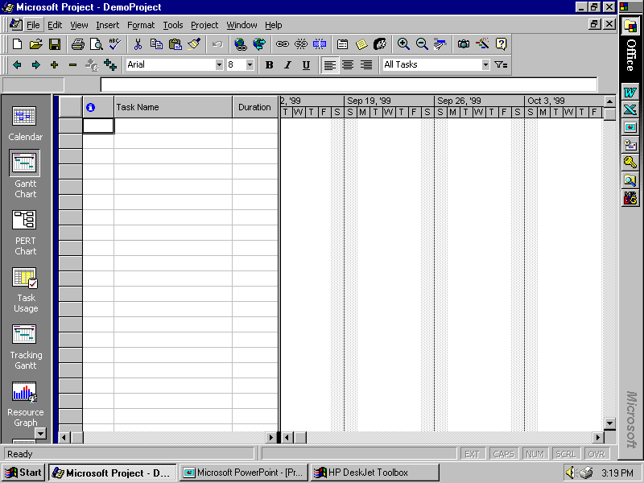

Slide 35
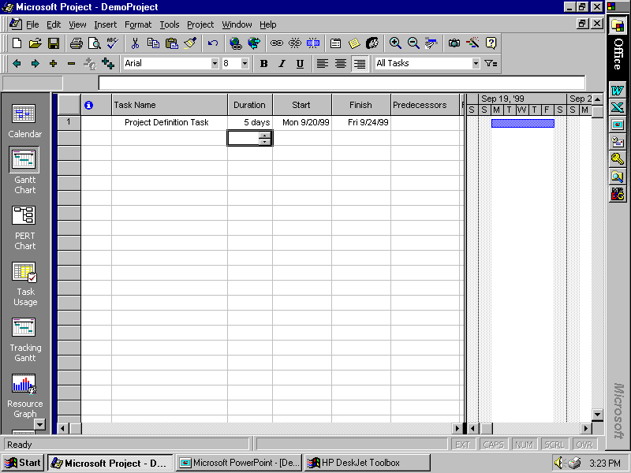

Slide 36
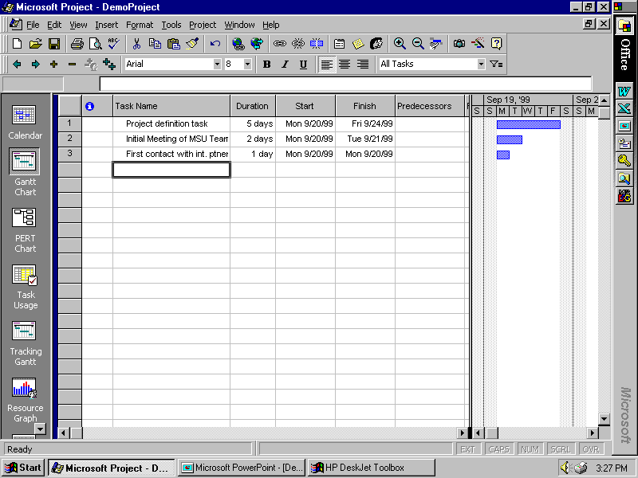

Slide 37
Project 98
Adding tasks, durations
Setting dependencies
Seeing critical path, etc.
“Rolling up” subtasks
Assigning resources
Adjusting durations, time assignments, etc.

Slide 38
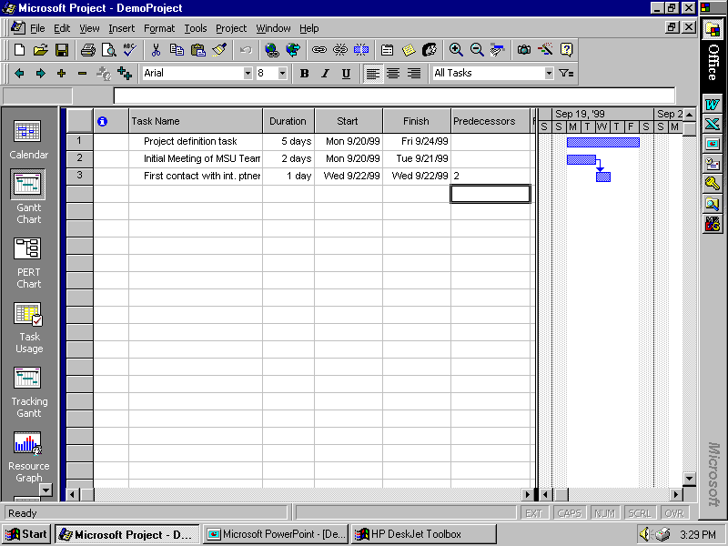

Slide 39
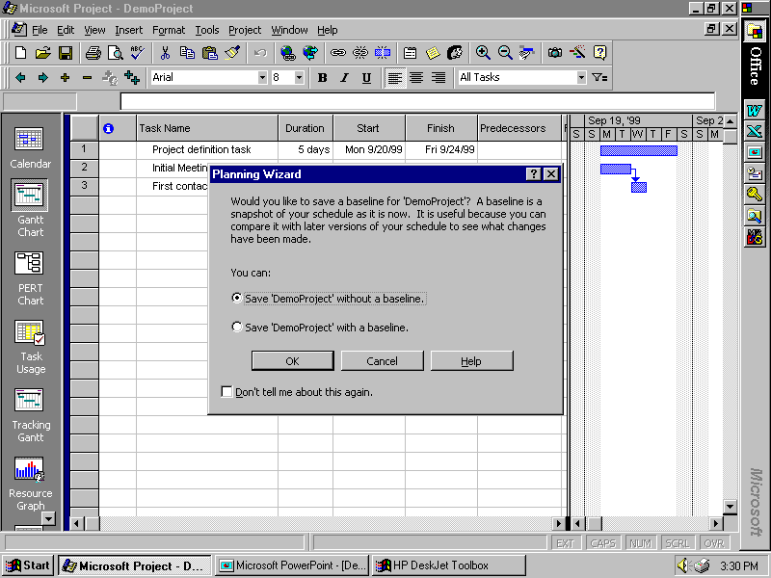

Slide 40
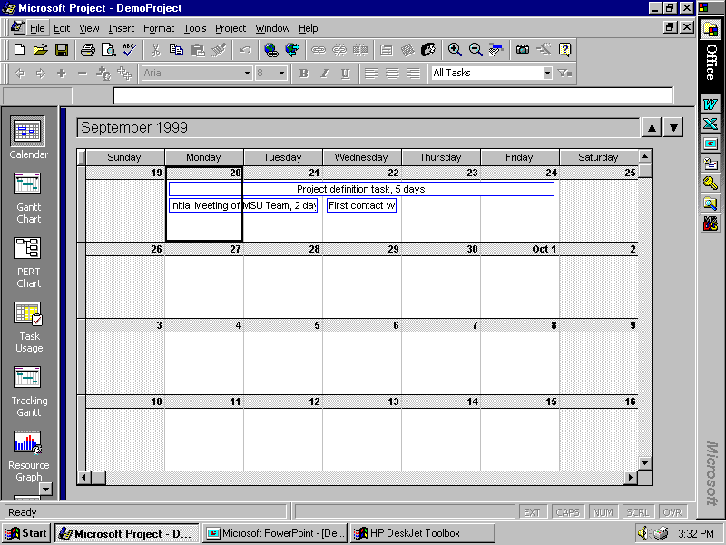

Slide 41
Project 98
Adding tasks, durations
Setting dependencies
Seeing critical path, etc.
“Rolling up” subtasks
Assigning resources
Adjusting durations, time assignments, etc.

Slide 42
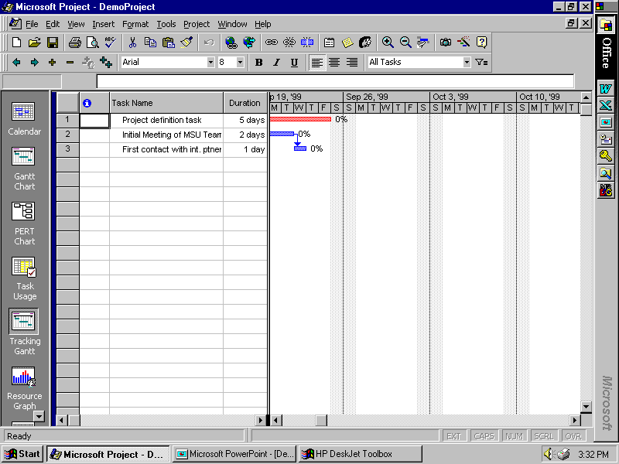

Slide 43
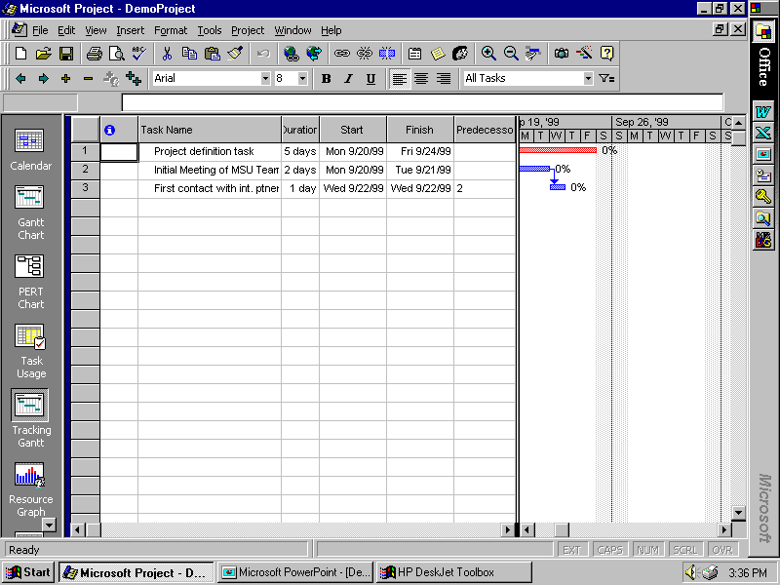

Slide 44
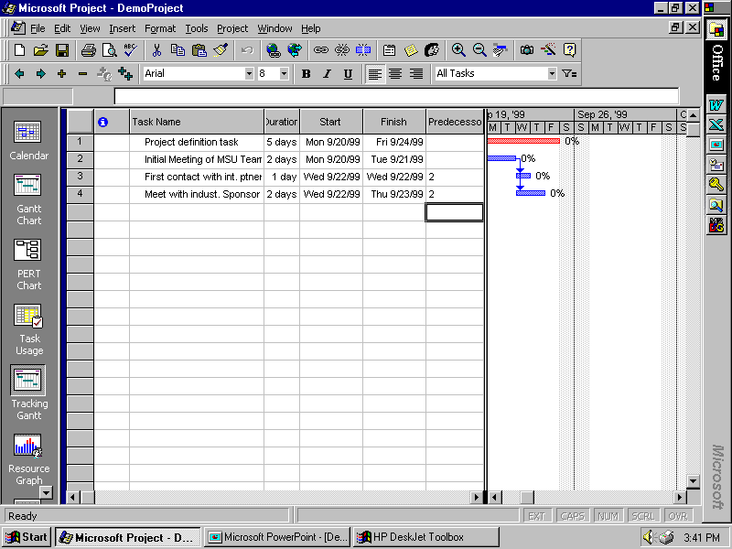

Slide 45
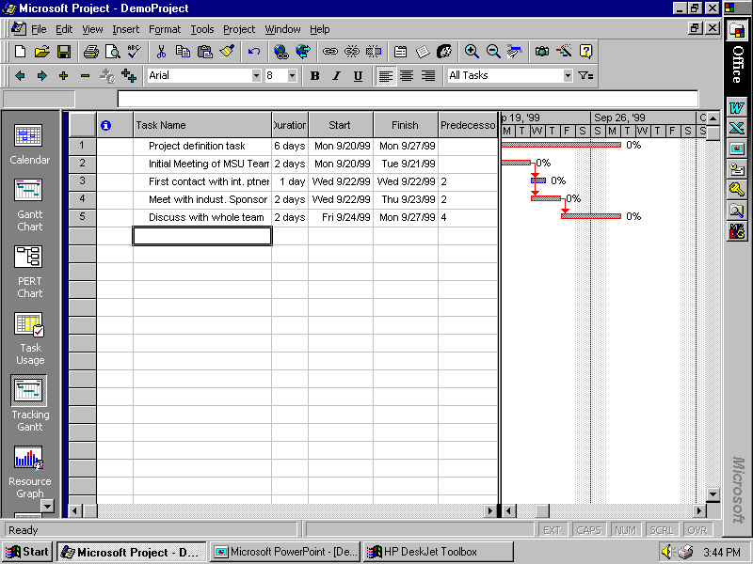

Slide 46
WATCH YOUR DEPENDENCY CHOICES!!!
If you choose something other than the “default” finish/start constraints, you will probably LOSE your ability to track the critical path
So AVOID “finish by” or “start by” with particular calendar dates, or other types of constraints.
Break tasks apart as needed, in order to make finish/start constraints realistic!

Slide 47
Project 98
Adding tasks, durations
Setting dependencies
Seeing critical path, etc.
“Rolling up” subtasks
Assigning resources
Adjusting durations, time assignments, etc.

Slide 48
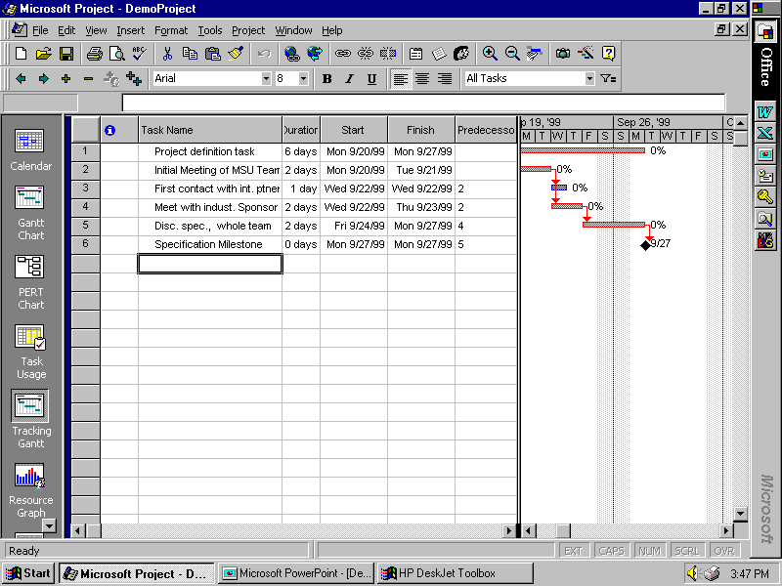

Slide 49
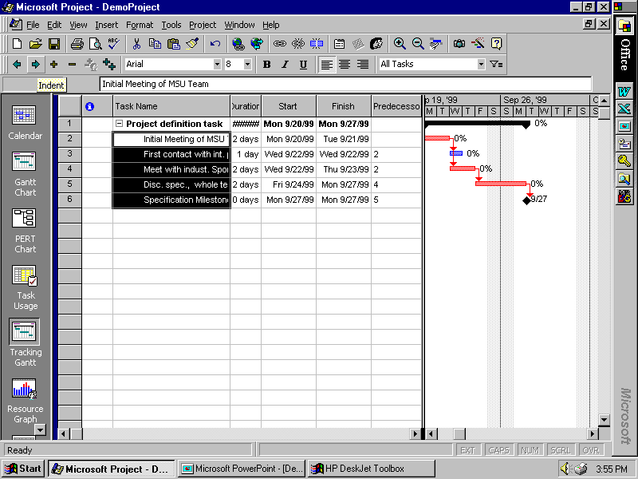

Slide 50
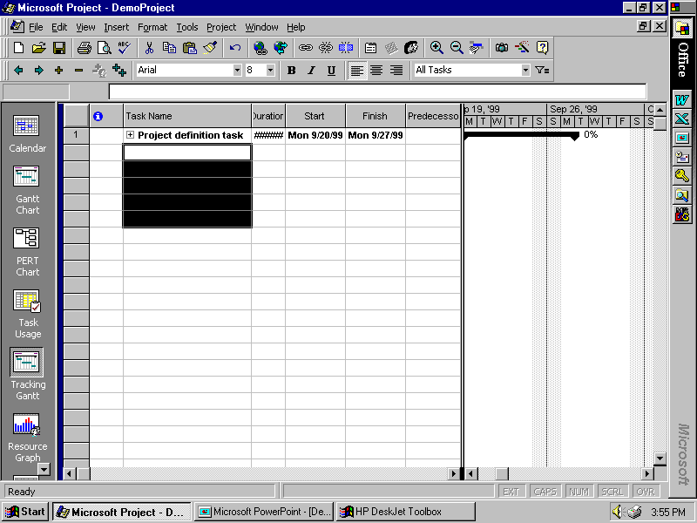

Slide 51
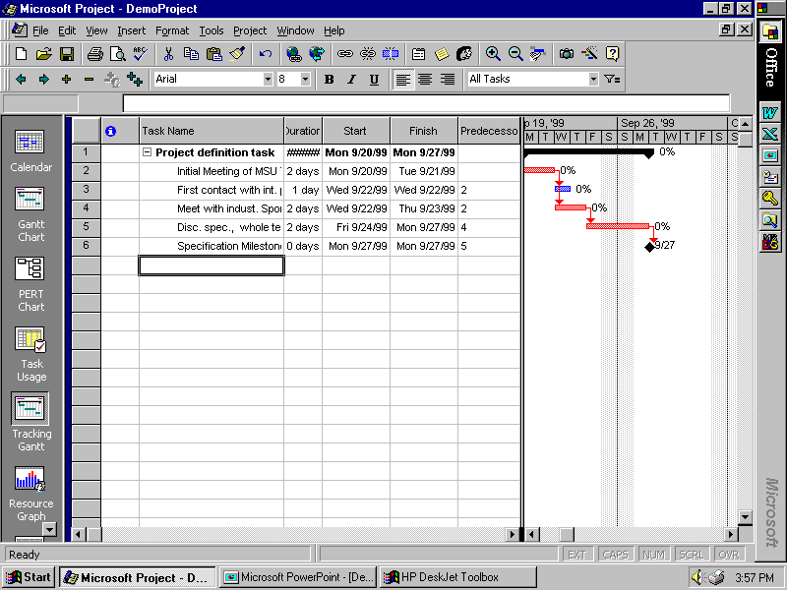

Slide 52
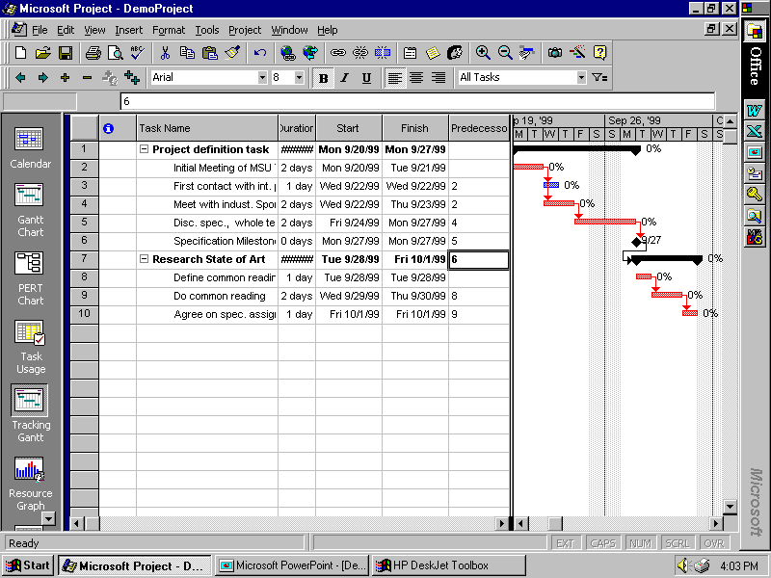

Slide 53
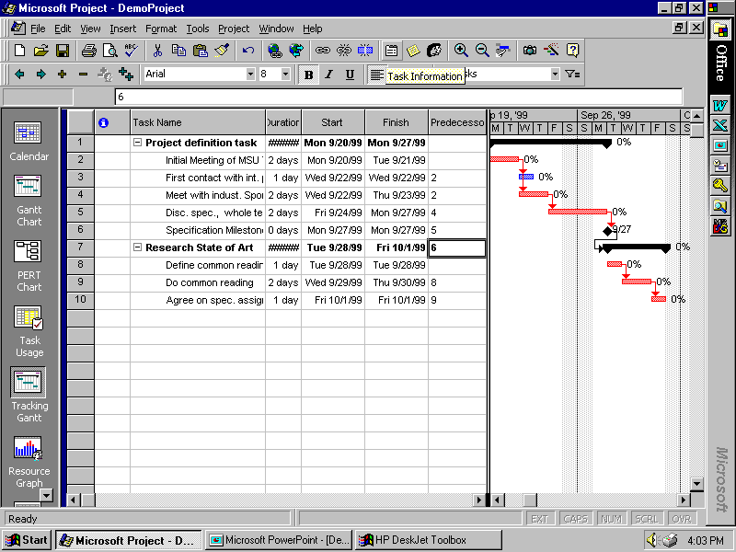

Slide 54
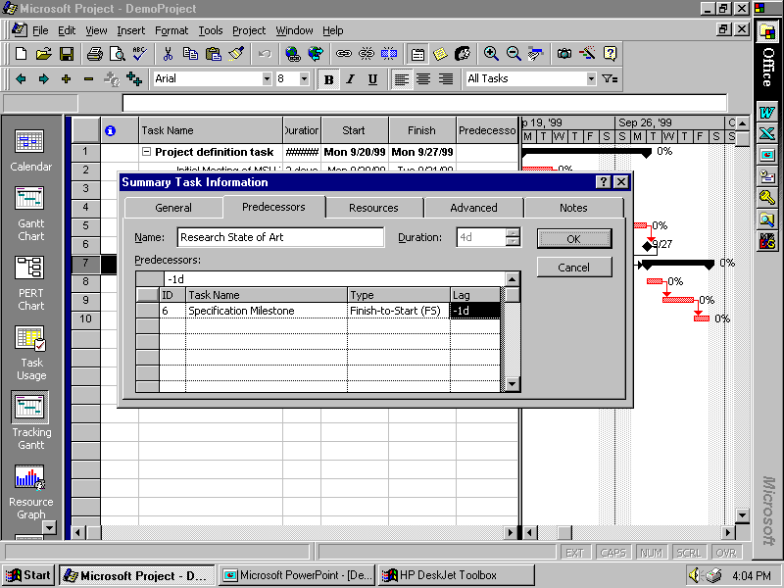

Slide 55
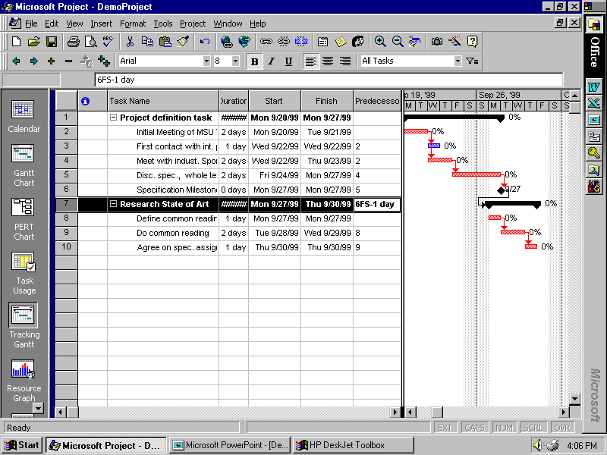

Slide 56
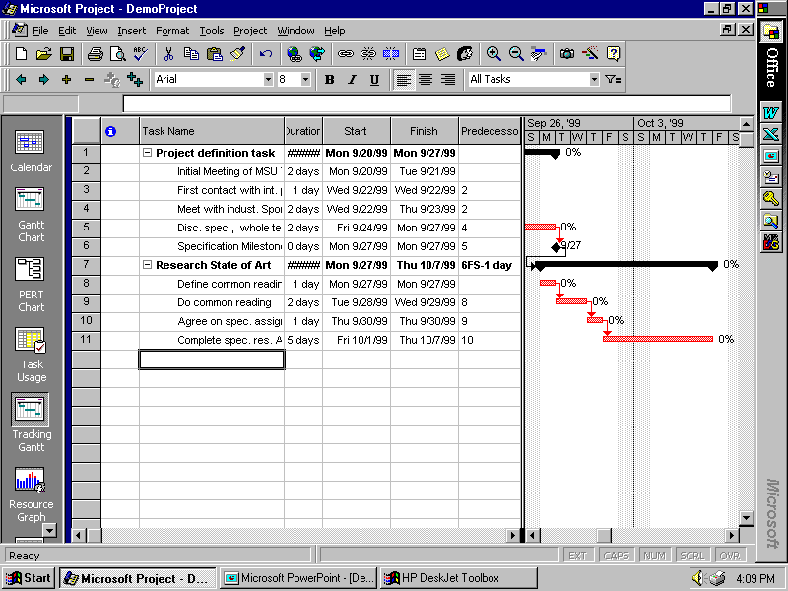

Slide 57
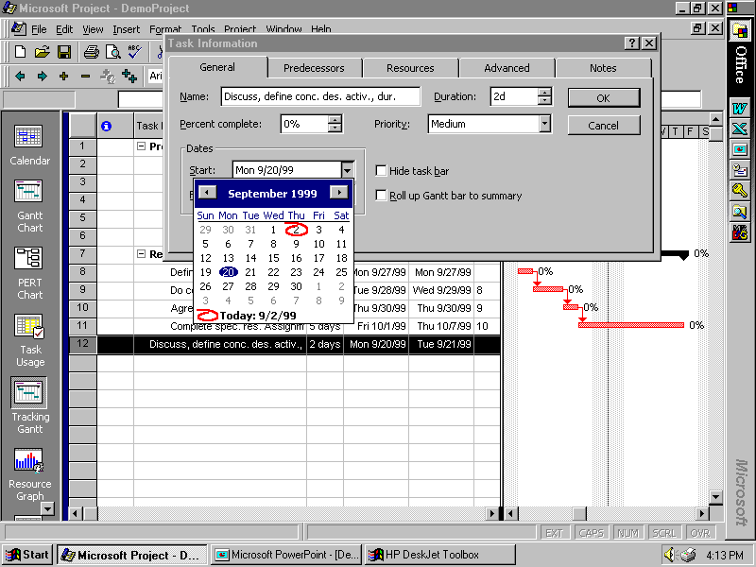

Slide 58
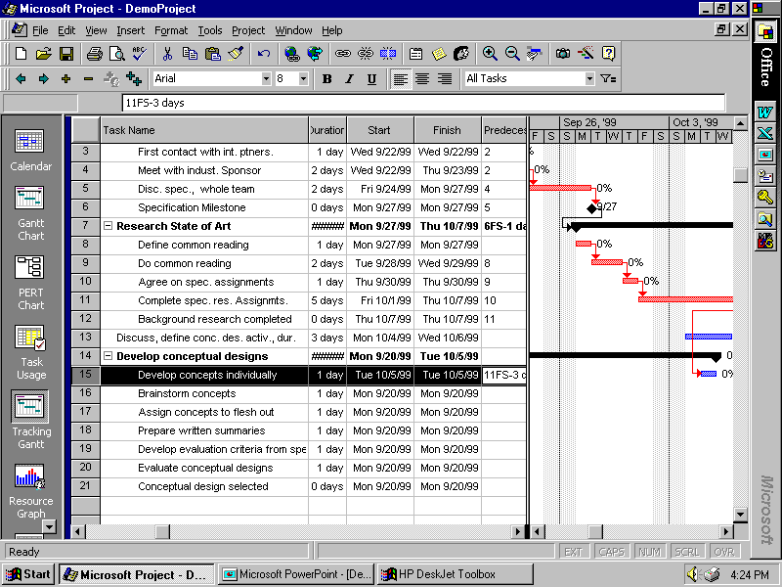

Slide 59
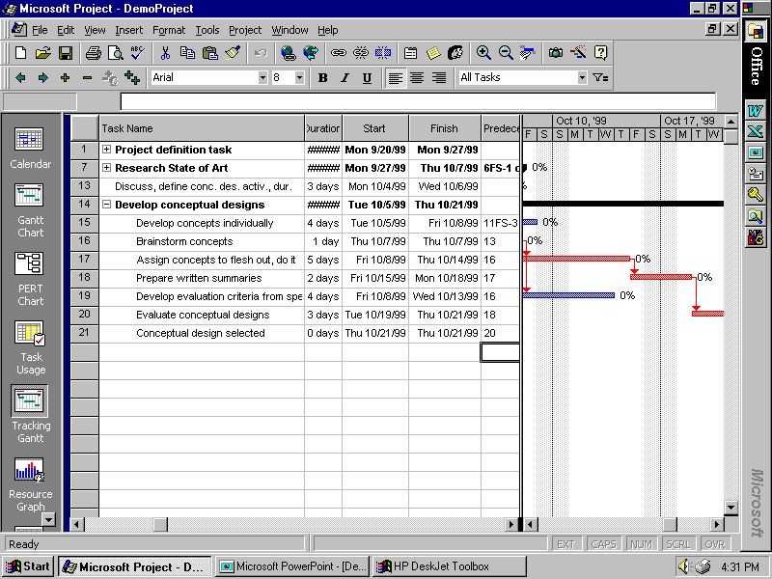

Slide 60
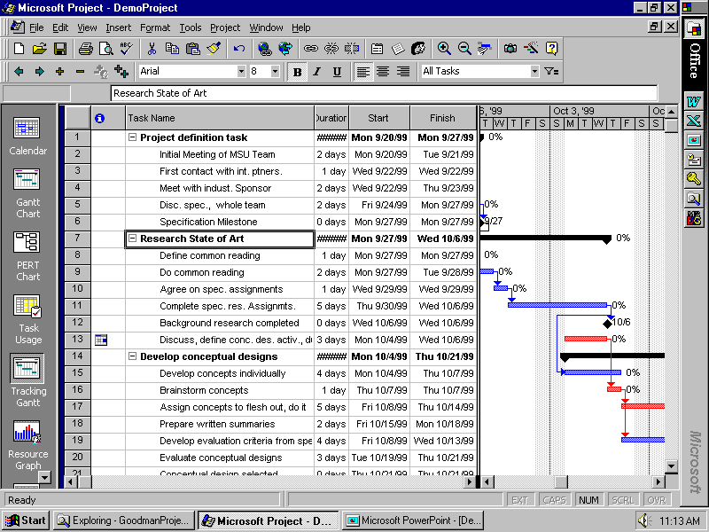

Slide 61
Project 98
Adding tasks, durations
Setting dependencies
Seeing critical path, etc.
“Rolling up” subtasks
Assigning resources
Adjusting durations, time assignments, etc.

Slide 62
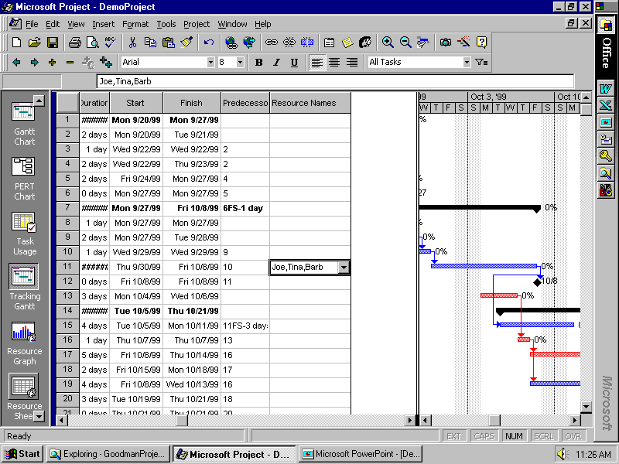

Slide 63
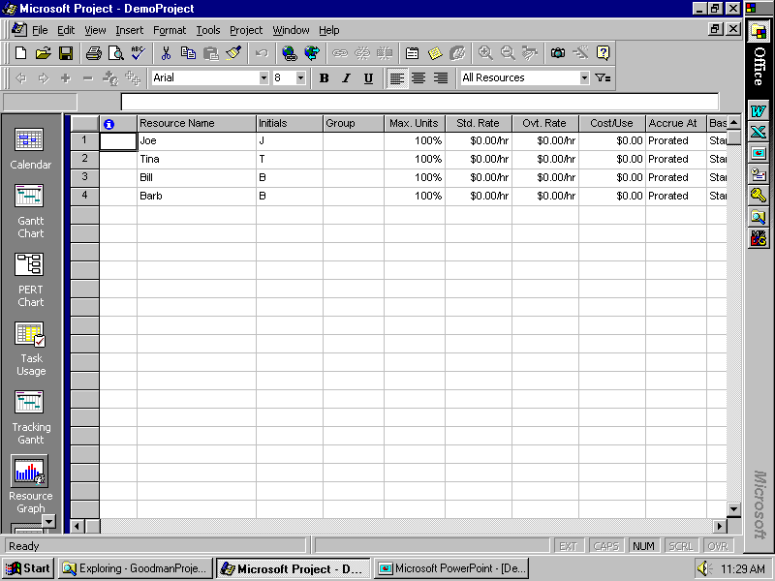

Slide 64
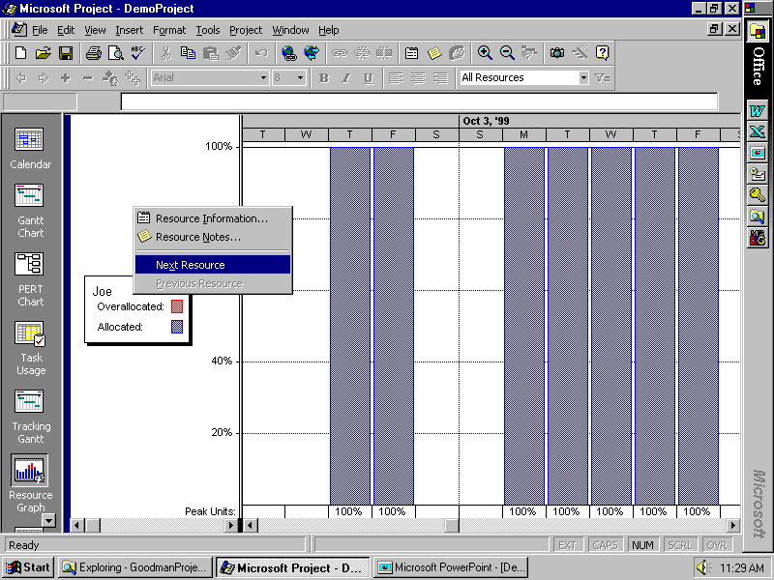

Slide 65
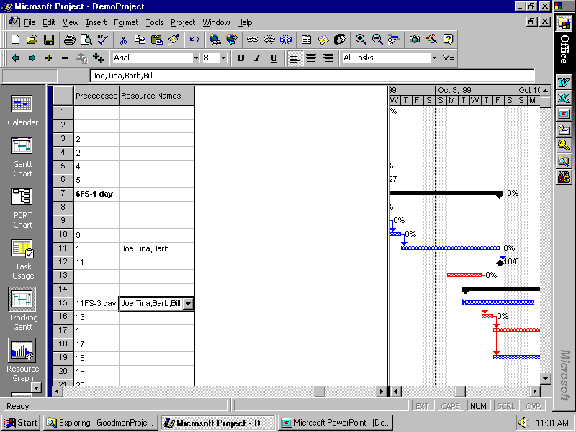

Slide 66
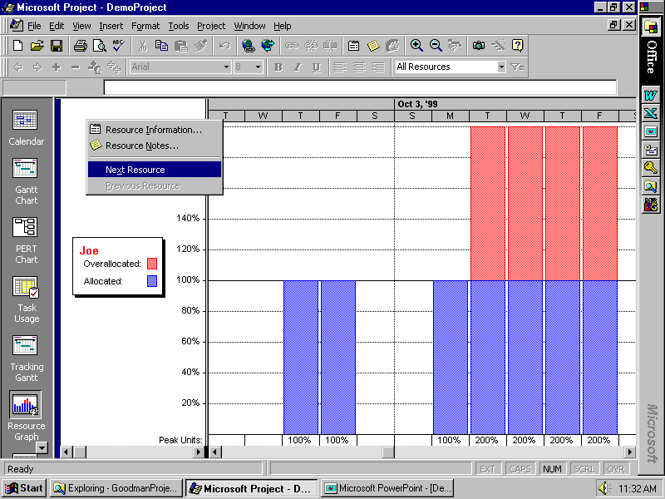

Slide 67
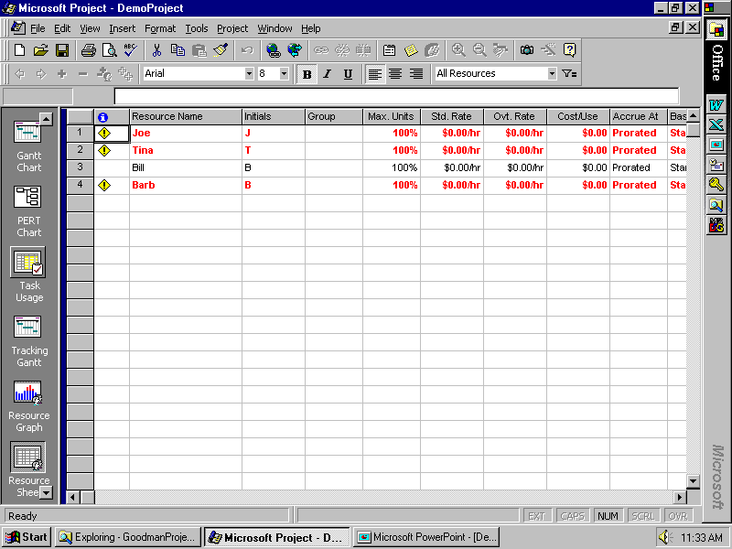

Slide 68
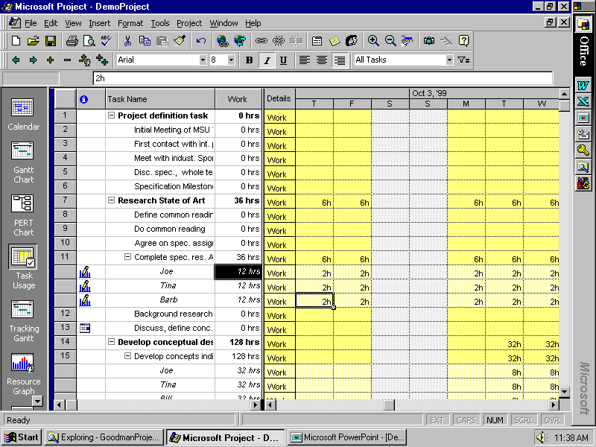

Slide 69
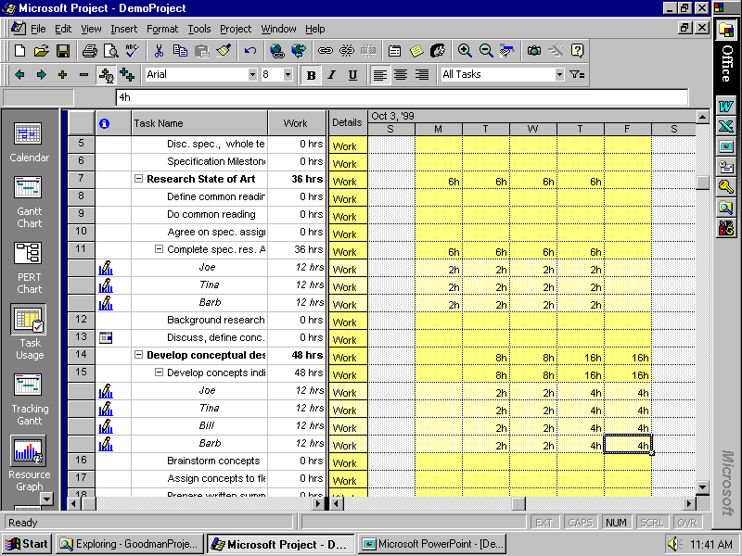

Slide 70
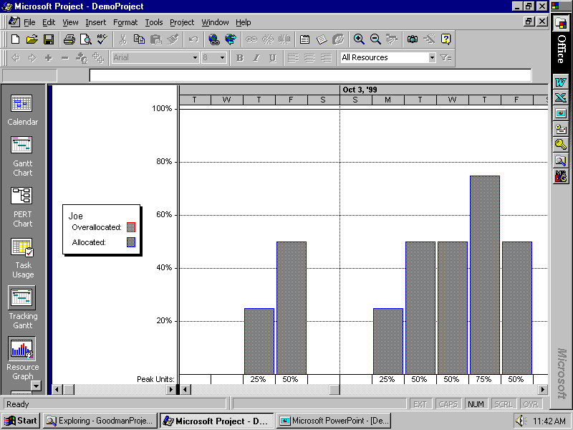

Slide 71
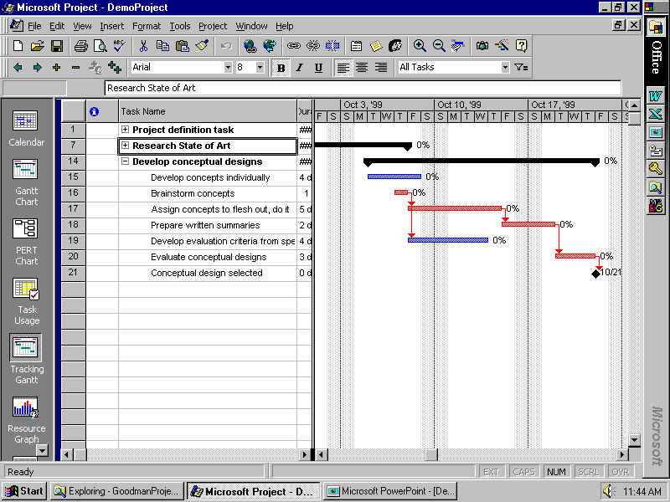

Slide 72
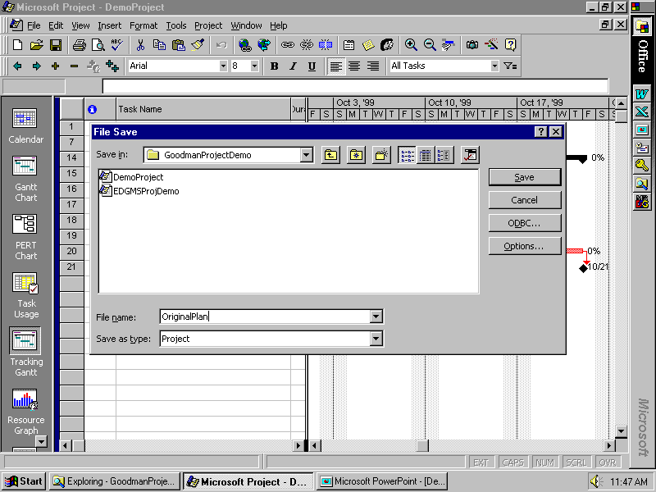

Slide 73
Project 98
Adding tasks, durations
Setting dependencies
Seeing critical path, etc.
“Rolling up” subtasks
Assigning resources
Adjusting durations, time assignments, etc.

Slide 74
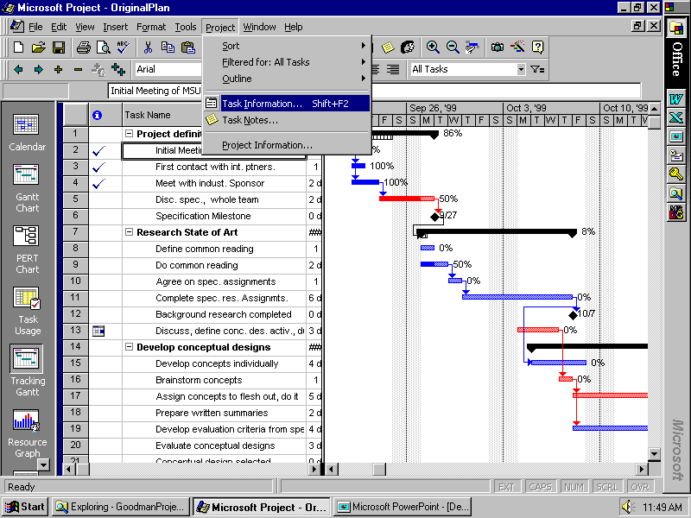

Slide 75
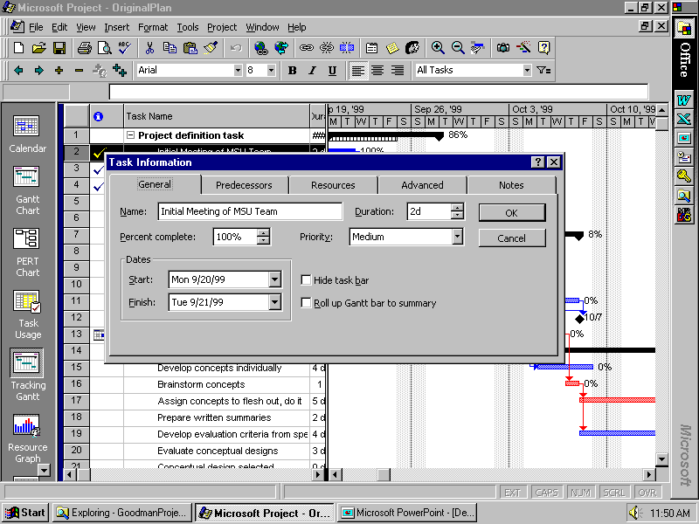

Slide 76
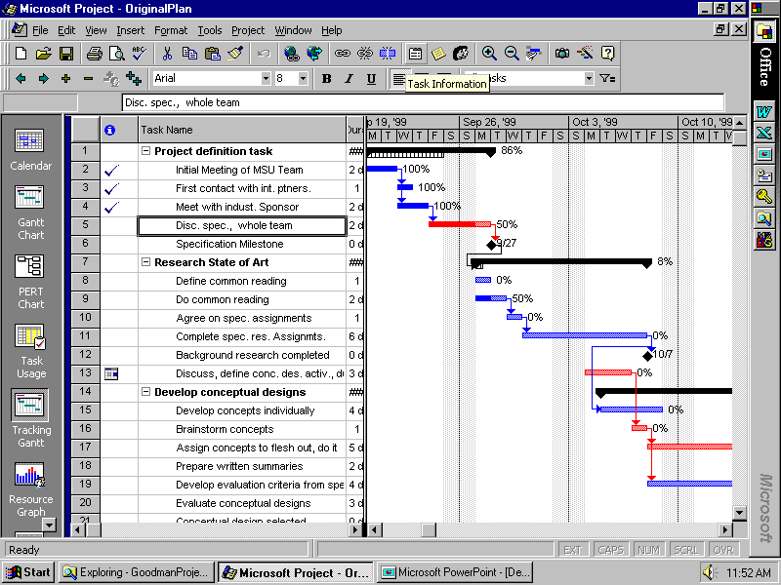

Slide 77
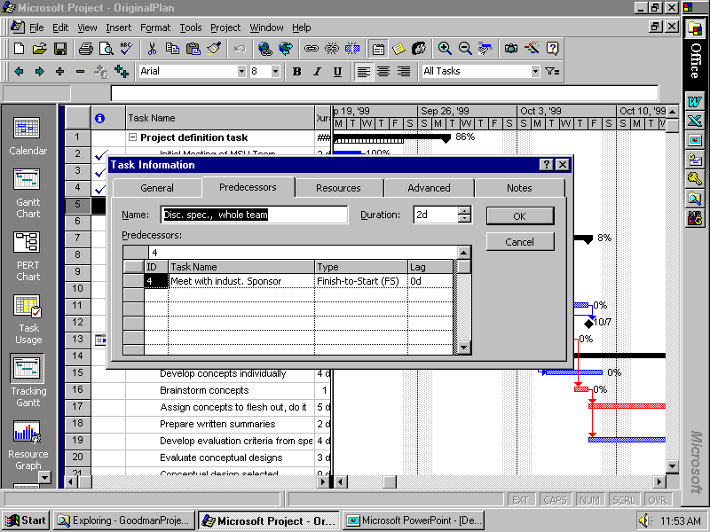

Slide 78
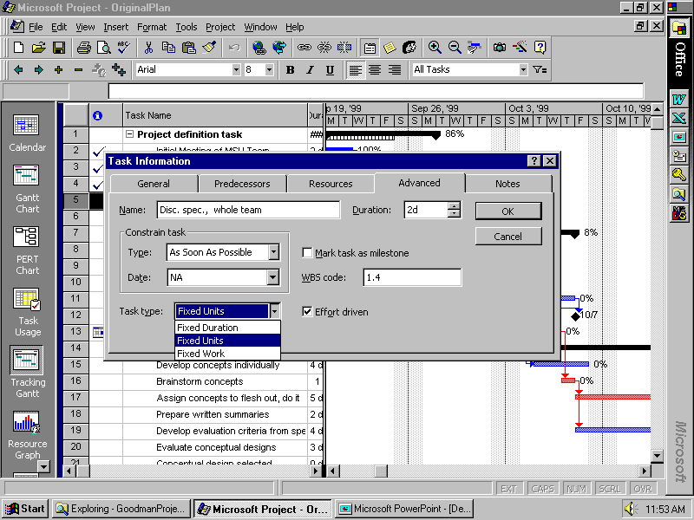

Slide 79
YOUR MS Project has a “Deadline” box
on this page! Use it to let you get warned when something gets pushed back too far, but STILL not assigning a “start no earlier than” or “finish no later than” constraint to it – still using “As soon as possible.”

Slide 80
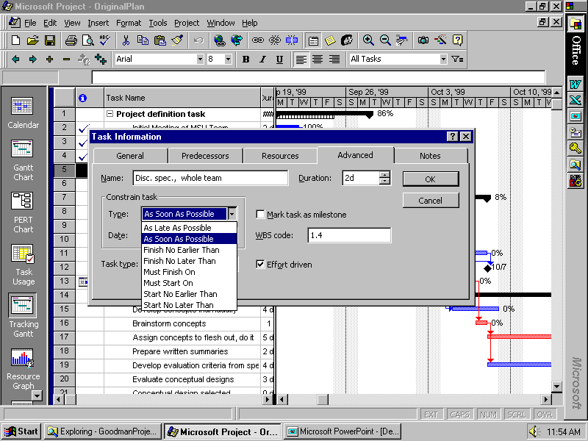

Slide 81
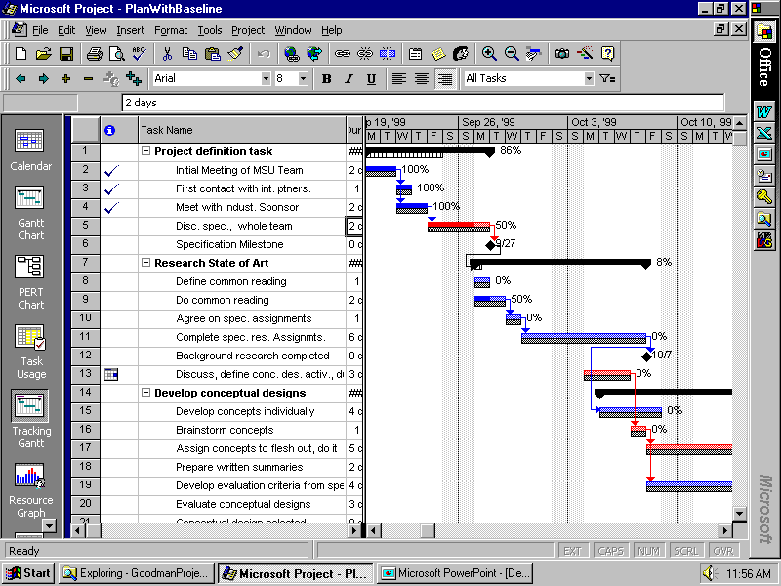

Slide 82
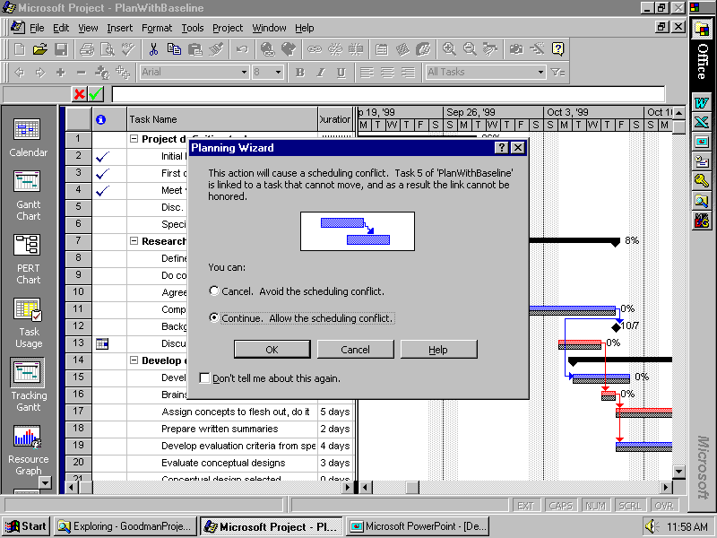

Slide 83
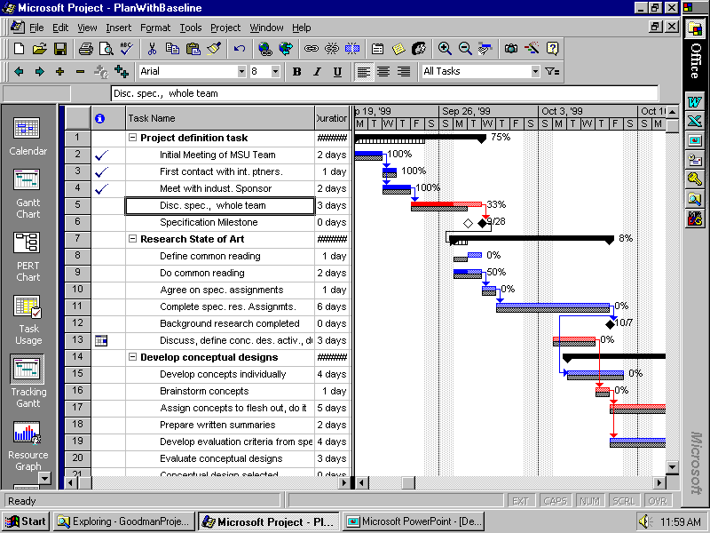

Slide 84
Management of YOUR Project
With your team members
Create a plan for the entire project
Set milestones for tracking progress
Provide more detail for near-term tasks
Use with your facilitator to report progress and revise/add detail to plan
Assign specific tasks to team members
Revise plan and activities as required to achieve objectives

